Slide 1

Under the guidance of:
Dr. D.C. Jinwala
HOD and Associate Professor
Computer Engineering Department
Submitted by:
Anshika Mehndiratta (U07CO205)
Bhavna Shivnani (U07CO209)
A.V. Aruna (U07CO212)

Slide 2
FLOW OF DISCUSSION
Introduction & Problem Statement
Theoretical Background
  Homomorphic Encryption
  Wireless Sensor Networks
  Elliptic Curve Cryptography
Related Work
Implementation
  Methodology of Evaluation
  Libraries investigated
  Test Application
  Profiling Tools Investigated
  Profiling
  Profiling Results
Conclusion & Future Research Areas

Slide 3
INTRODUCTION
Secure transmission of data – encryption required
Homomorphic encryption - processing data ensuring privacy
Increasing use of wireless devices
Use ECC – less resource intensive cryptographic scheme
Problem statement
  Implement test programs of three ECC algorithms – ECIES, ECDSA & ECDH
  Profiling the above three algorithms to perform a comparative study of their execution time and resource consumptions.

Slide 4
HOMOMORPHIC ENCRYPTION
Helps to manipulate encrypted data in meaningful way without knowing the secret key
Performs algebraic operations on plaintext another algebraic operation on ciphertext - Decryption of processed ciphertext = processed plaintext
Functionality
  KeyGen_{ε}(constant)
  Encrypt_{ε} (pk, m_{i})
  Decrypt_{ε} (sk, c)
  Evaluate_{ε}

Slide 5
HOMOMORPHIC ENCRYPTION
Security requirements – semantically secure & probabilistic
Fully homomorphic encryption - handles all algebraic functions
Somewhat homomorphic encryption – handles limited class of algebraic functions – for which noise within limits
Bootstrappable encryption – self referential encryption
Bootstrappable to fully homomorphic – recursive use of bootstrappable
Somewhat homomorphic to bootstrappable - simplification of decryption circuit

Slide 6
WIRELESS SENSOR NETWORKS
Limitations
Energy
Memory
Transmission Range
Fault Tolerance
Self-Organization
Scalability
Hence, protocols designed for sensor networks should be highly scalable.

Slide 7
WIRELESS SENSOR NETWORKS
Attacks
Based On The Capability Of The Attacker
Attacks On Information in Transit
Host-Based Vs Network Based Attacks
Based On Protocol Stack

Slide 8
WIRELESS SENSOR NETWORKS
Security Requirements
Authentication
Access-control
Privacy
Integrity
Authorization
Anonymity
Non-repudiation
Resilience
Forward and Backward secrecy
Survivability

Slide 9
ELLIPTIC CURVE CRYPTOGRAPHY
ECC is public key cryptography
Public key algorithm requires a set of predefined constants – known by all devices participating in communication
Predefined constants of ECC – Domain Parameters
Mathematical operation - defined over Elliptic Curve
Advantages of ECC:
  Small key size
  160-bit key in ECC equivalent to 1024-bit key in RSA
  Less resource consumption – processing power, memory & time

Slide 10
ELLIPTIC CURVE CRYPTOGRAPHY
ECDSA (Elliptic Curve Digital Signature Algorithm)
Signature algorithm required for authenticating devices or messages
ECDSA
  Variant of DSA
  Operates on Elliptic Curve groups
  Elliptic Curve domain parameters have to be agreed upon for signing messages
ECDSA steps
  Signature generation
  Signature verification

Slide 11
ELLIPTIC CURVE CRYPTOGRAPHY
ECIES (Elliptic Curve Integration Encryption Scheme)
ECIES
  Public key encryption scheme
  Provides semantic security against chosen plaintext and chosen ciphertext attacks
  Based on Diffie – Hellman problem
Requirements
  Cryptographic suite
  EC domain parameters
  Receiver’s public key
  Shared information of 2 parties

Slide 12
ELLIPTIC CURVE CRYPTOGRAPHY
ECDH (Elliptic Curve Diffie - Hellman)
Parties calculate shared key for private key algorithm
Third party not having access to private details cannot calculate shared key
ECDH
  A key agreement protocol
  Allows two parties to establish shared key
  For private key algorithm

Slide 13
RELATED WORK
Earlier Researches
  TinyECC library on TinyOS
  Mote based simulation
and conclusion
  Processor-based profilers
  ECC operations & EEA algorithm profiled
  Implementation and profiling on different word size processors
Our Work
  CryptoPP library(C++)
  Implementation of real world application
  Linux based profiler
  ECIES,ECDSA & ECDH profiled
  Implementation and profiling different algorithms on same hardware

Slide 14
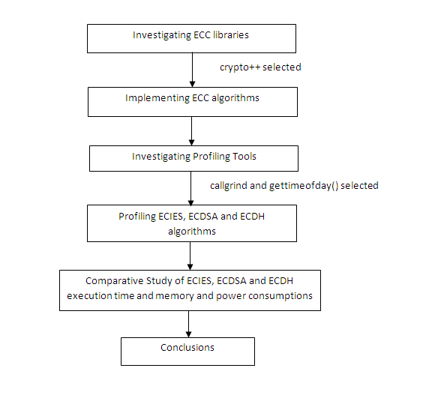
IMPLEMENTATION

Slide 15
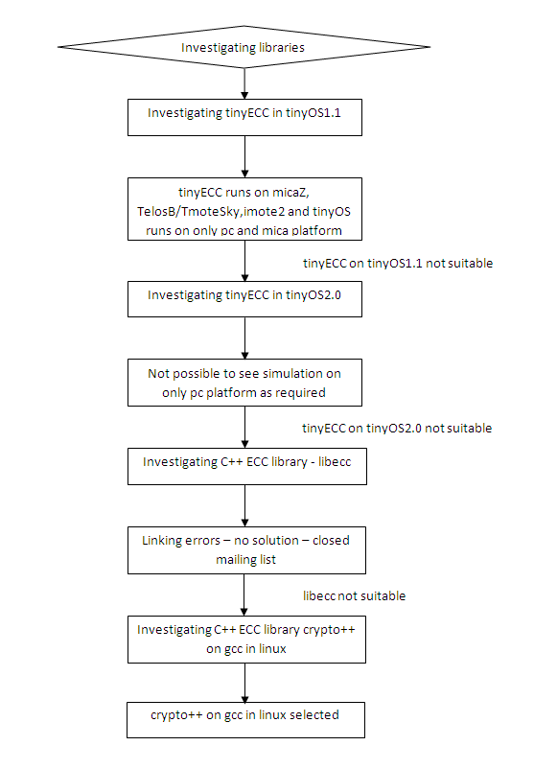
LIBRARIES INVESTIGATED

Slide 16
LIBRARIES INVESTIGATED
TinyECC
Software package providing ECC-based PKC operations
Used in sensor network applications
Problems faced
  TinyOS 1.1
    supports the mica & pc platforms.
    Our requirement - simulation on pc platform
    tinyECC doesn’t support pc platform
  TinyOS 2.0
    supports the platforms required for TinyECC
    not possible to see the simulation on pc

Slide 17
LIBRARIES INVESTIGATED
libecc
C++ ECC library
supports fixed-size keys for maximum speed
on Turbo C++,Microsoft Visual C++ & GCC
tested with libecc version 0.12.1 on Microsoft Visual C++ and gcc
Problems faced
  Linking errors - could not be resolved due to closed mailing list

Slide 18
LIBRARIES INVESTIGATED
Crypto++
a free and open source C++ class library
fully supports 32-bit and 64-bit architectures on many OS
compilation under a variety of compilers and IDEs
version investigated was crypto++5.5.2 on GCC in Linux.
Successful implementation of test applications
Library chosen

Slide 19
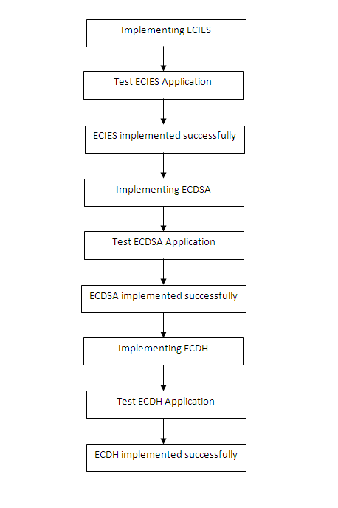
TEST APPLICATION
Our test application consists of 3 algorithms:
  ECIES
  ESDSA
  ECDH
The test data - “Blood Transfusion Service Centre Data Set”
taken from “UCLA repository"

Slide 20
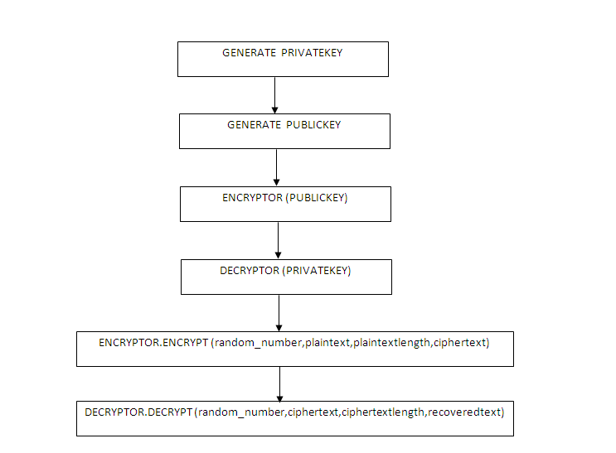
TEST APPLICATION - ECIES

Slide 21
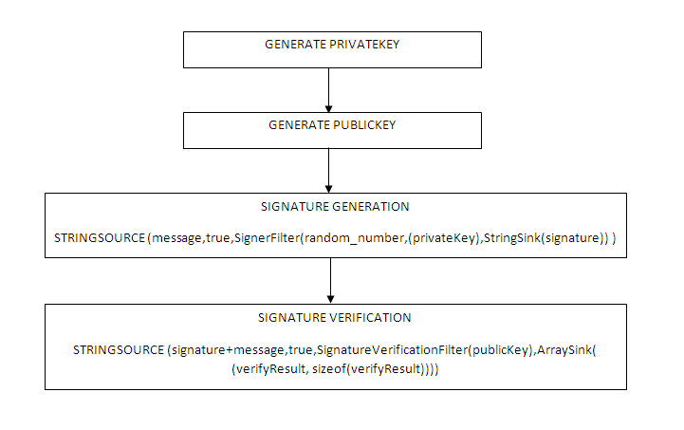
TEST APPLICATION - ECDSA

Slide 22
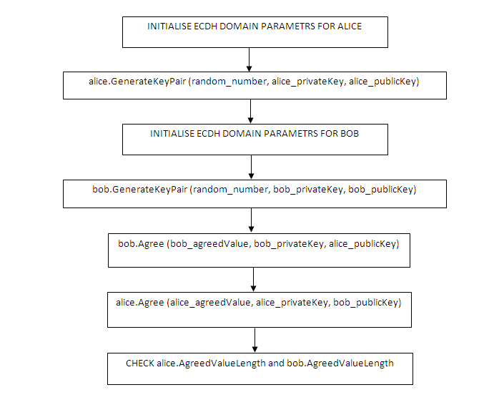
TEST APPLICATION - ECDH

Slide 23
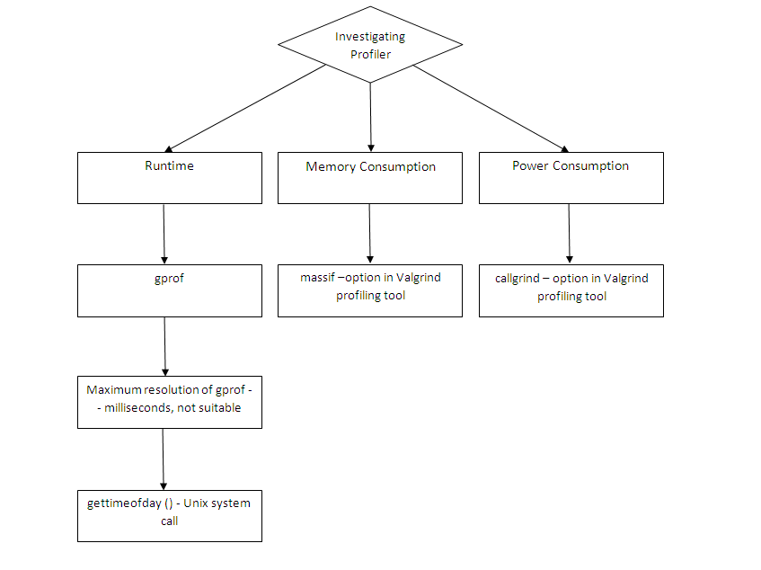
PROFILING TOOLS INVESTIGATED

Slide 24
PROFILING TOOLS INVESTIGATED
Gprof
  Maximum resolution is in milliseconds.
  Our applications requires a microsecond resolution timer.
  Not suitable for our application.
gettimeofday() - UNIX system call
  obtains the current time
  expressed as seconds and microseconds since the Epoch.
  Stores it in timeval structure pointed to by 'tp'.
  Returns 0 or no value to indicate error.
  Suitable for our application

Slide 25
PROFILING TOOLS INVESTIGATED
Valgrind
  An instrumentation framework for building dynamic analysis tools.
  The two production quality tools of valgrind we used:
    Massif – a heap profiler
    Callgrind – an extension to cachegrind which provides extra information about callgraphs.

Slide 26
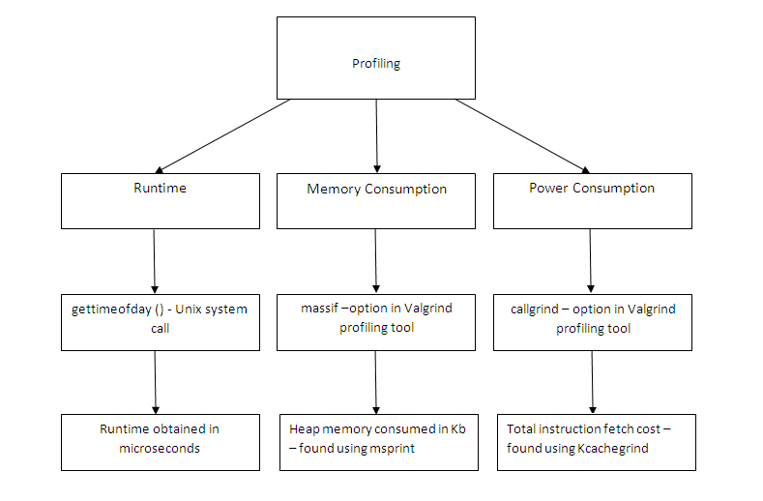
PROFILING

Slide 27
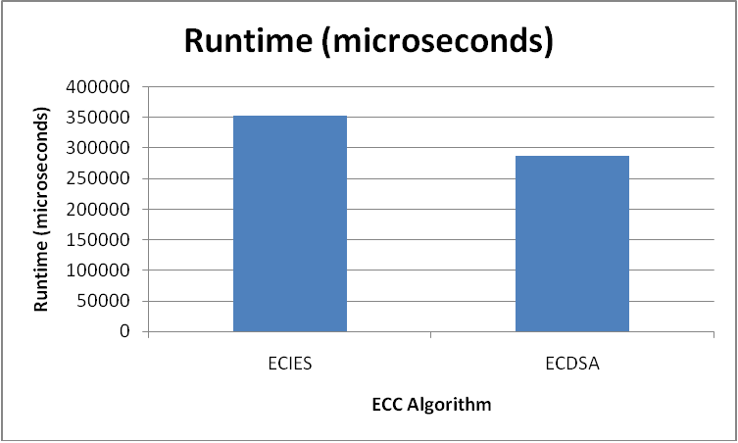
PROFILING RESULTS – RUNTIME
Algorithm | Runtime (microseconds)
ECIES | 352810
ECDSA | 287332
ECDH | 28027
PROGRAM | FUNCTION | RUNTIME(microseconds)
ECIES | Encryptor.Encrypt() | 6614
 | Decryptor.Decrypt() | 4267
ECDSA | Signer.SignandRestart() | 3398
 | Verifer.VerifyandRestart() | 5859

Slide 28
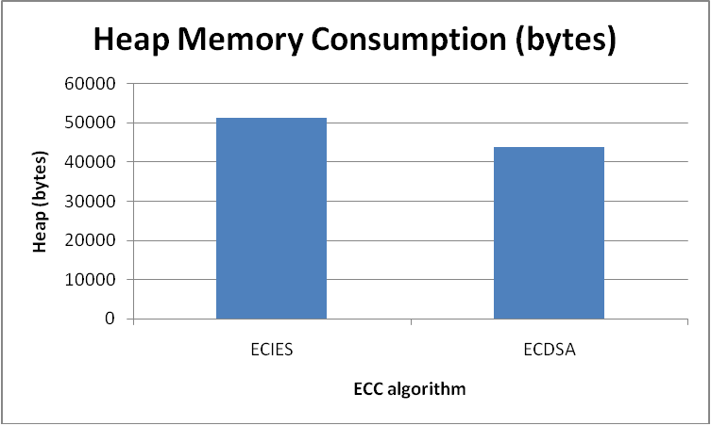
PROFILING RESULTS – MEMORY
Algorithm | Heap Memory (bytes)
ECIES | 51424
ECDSA | 43880
ECDH | 15680
PROGRAM | FUNCTION | MEMORY (bytes)
ECIES | Encryptor.Encrypt() | 2880
 | Decryptor.Decrypt() | 1536
ECDSA | Signer.SignandRestart() | 512
 | Verifer.VerifyandRestart() | 704

Slide 29
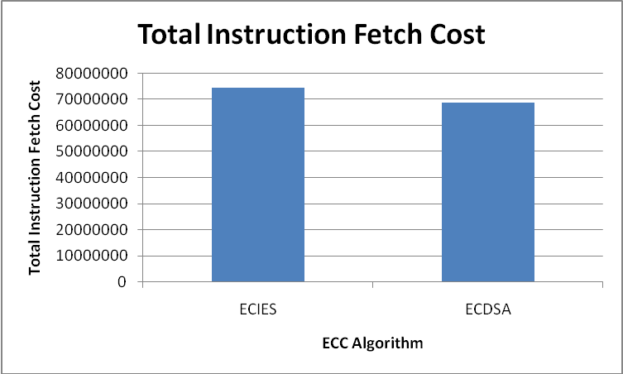
PROFILING RESULTS – POWER
Algorithm | Total Instruction Fetch Cost
ECIES | 747 138 248
ECDSA | 688 745 567
ECDH | 52 746 600
PROGRAM | FUNCTION | INSTRUCTION FETCH COST
ECIES | Encryptor.Encrypt() | 375 066 958
 | Decryptor.Decrypt() | 254 377 276
ECDSA | Signer.SignandRestart() | 193 260 215
 | Verifer.VerifyandRestart() | 373 410 525

Slide 30
CONCLUSION
Chose crypto++ library after investigating TinyECC & libecc
Implemented the three ECC algorithms, namely ECDSA, ECIES and ECDH using Crypto++ 5.5.2.
Chose Valgrind profiling framework for memory and power profiling; and gettimeofday() system call for runtime profiling
Analyzed the results and the algorithms for their suitability to different applications.

Slide 31
FUTURE RESEARCH AREAS
Extending each of the ECC algorithms to include the complete set of security features
Improvement of ECDH and ECDSA algorithms to implement ECMQV and ECNR respectively.
Using the improvised algorithms and their results for use in Wireless Sensor Networks, where ECC algorithms hold prime importance in providing security in a memory and power constrained environment.
Cross language implementation of ECC algorithms utilizing the capabilities and features of other languages like Java.
Improving the performance, integration cost and overhead of inter-processor communication for ECC algorithms.

Slide 32


